Slide 1
DEATH AND RESURRECTION
Lesson 12 for September 20, 2014

Slide 2
THE STATE OF THE DEAD
“For the living know that they will die; but the dead know nothing, and they have no more reward, for the memory of them is forgotten.” (Ecclesiastes 9:5)
“Our friend Lazarus sleeps, but I go that I may wake him up.” (John 11:11)
“For now I would have lain still and been quiet, I would have been asleep; then I would have been at rest.” (Job 3:13)
“So man lies down and does not rise. Till the heavens are no more, they will not awake nor be roused from their sleep.” (Job 14:12)
“Enlighten my eyes, lest I sleep the sleep of death.” (Psalm 13:3)
“And sleep a perpetual sleep and not awake.” (Jeremiah 51:39)
“And many of those who sleep in the dust of the earth shall awake.” (Daniel 12:2)
DEATH IS A STATE OF UNCONSCIOUSNESS

Slide 3
THE STATE OF THE DEAD
“For the living know that they will die; but the dead know nothing, and they have no more reward, for the memory of them is forgotten.” (Ecclesiastes 9:5)
DEATH IS A STATE OF INACTIVITY
“But the dead know nothing, and they have no more reward, for the memory of them is forgotten.” (Ecclesiastes 9:5)
“Also their love, their hatred, and their envy have now perished; nevermore will they have a share in anything done under the sun.” (Ecclesiastes 9:6)
“For there is no work or device or knowledge or wisdom in the grave where you are going.” (Ecclesiastes 9:10)
“The dead do not praise the Lord, nor any who go down into silence.” (Psalm 115:17)
“His spirit departs, he returns to his earth; in that very day his plans perish.” (Psalm 146:4)

Slide 4
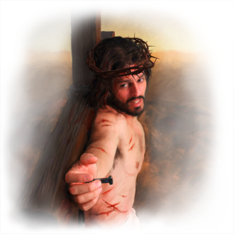
THE ODD CASE OF THE GOOD THIEF
“And Jesus said to him, ‘Assuredly, I say to you today, you will be with Me in Paradise.’” (Luke 23:43)
Luke wrote in Greek without using punctuation marks. He wrote:
“Assuredly I say to you today you will be with Me in Paradise.”
The meaning of that sentence may change depending on the punctuation marks we add.
“Assuredly I say to you, today you will be with Me in Paradise.”
“Assuredly, I say to you today, you will be with Me in Paradise.”
In that case, both Jesus and the thief would be in Paradise that same day. Nevertheless, when Jesus resurrected the third day, He said that He had not yet ascended to the Father; so He had not been to Paradise yet (John 20:17)
Jesus answered the thief’s request by promising him that they would be together in paradise “when You come into Your kingdom.” (Luke 23:42)
The second meaning is the only coherent one, according to the rest of the Bible on the death and resurrection of Jesus and the state of the dead.

Slide 5
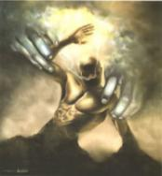
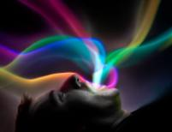
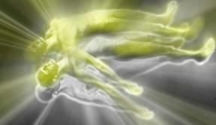
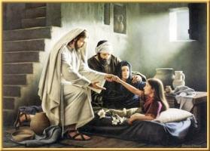
LIFE, DEATH AND RESURRECTION
“These all wait for You, that You may give them their food in due season. What You give them they gather in; You open Your hand, they are filled with good. You hide Your face, they are troubled; You take away their breath, they die and return to their dust. You send forth Your Spirit, they are created; and You renew the face of the earth.” (Psalm 104:27-30)
Life is fully dependent on the spirit or breath of life that God gives us.
LIFE: God “breathes” the spirit of live into His creatures (Genesis 2:7)
DEATH: God takes the spirit of life away from us; it returns to Him (Ecclesiastes 12:7)
RESURRECTION: God brings the spirit of life back into us (Luke 8:55)
Only Jesus has life in Himself (John 5:26). So He is the only One who is able to resurrect the dead (John 5:21)

Slide 6
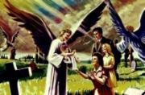
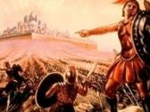
THE TWO RESURRECTIONS
“Do not marvel at this; for the hour is coming in which all who are in the graves will hear His voice and come forth—those who have done good, to the resurrection of life, and those who have done evil, to the resurrection of condemnation.” (John 5:28-29)
Everyone dies and everyone will be resurrected. After our death, the judgment decides the type of resurrection we will experience.
RESURRECTION FOR LIFE
Those who have faith in Jesus; their works show their faith is genuine (John 3:16; James 2:18-20)
At the Second Coming of Christ (1Co. 15:22-23)
To live forever (1Ts. 4:17)
RESURRECTION FOR CONDEMNATION
Those who reject Jesus or refuse to live according to the life rules He established.
After the Millennium (Rev. 20:5)
To die forever (Ro. 6:23)
Who?
When?
What for?

Slide 7
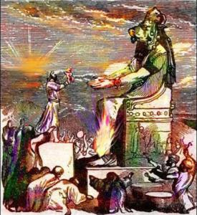
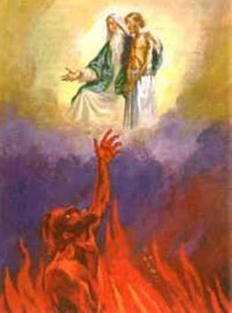
HELL
“If your hand causes you to sin, cut it off. It is better for you to enter into life maimed, rather than having two hands, to go to hell, into the fire that shall never be quenched.” (Mark 9:43)
Jesus used two Greek words for death and the punishment of the wicked, hadēs and gehena.
HADĒS
Grave, symbolic place where the death rest. Same as the Hebrew Sheol.
Jesus figuratively used this term in the parable of the rich man and Lazarus (Lk. 16:19-31). He used that parable to explain that decisions must been made in this life, not after death.
GEHENA
Hell. It makes reference to the valley of Hinnom where idols were worshipped. Jeremiah prophesied that God would make it a “Valley of Slaughter” (Jer. 7:32, 33; 19:6)

Slide 8
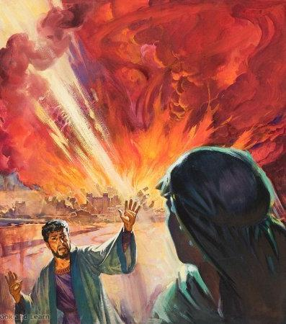
HELL
“If your hand causes you to sin, cut it off. It is better for you to enter into life maimed, rather than having two hands, to go to hell, into the fire that shall never be quenched.” (Mark 9:43)
Will the wicked be burning forever in a sea of fire?
“as Sodom and Gomorrah, and the cities around them in a similar manner to these, having given themselves over to sexual immorality and gone after strange flesh, are set forth as an example, suffering the vengeance of eternal fire.” (Jude 7)
According to Jude, the wicked will be burned in the same eternal fire that consumed Sodom. The fire in Sodom was quenched after it destroyed everything that had to be burned. That fire was extinguished long ago, but its aftermath is forever.

Slide 9
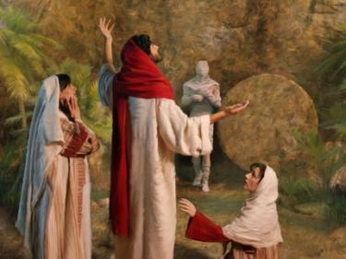
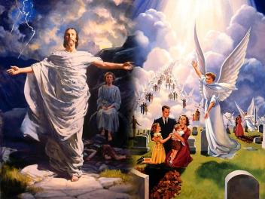
JESUS AND THE RESURRECTION
“Jesus said to her, ‘I am the resurrection and the life. He who believes in Me, though he may die, he shall live.’” (John 11:25)
Lazarus had been dead for four days. The stench testified to the rotting of his body.
A great crowd gathered there because of Lazarus’ death. There Jesus showed His power over death by doing the “top” miracle in His ministry.
Jesus resurrected several people during His ministry. But the true resurrection guarantee is the resurrection of Jesus Himself.
“knowing that He who raised up the Lord Jesus will also raise us up with Jesus, and will present us with you.” (2 Corinthians 4:14)

Slide 10
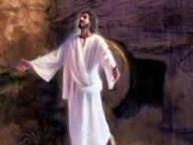
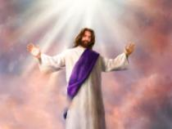
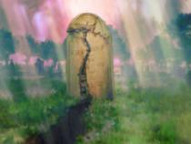
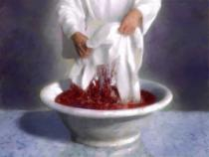
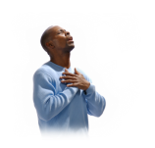
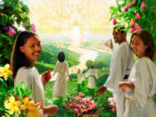
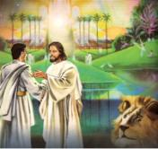
“The resurrection and ascension of our Lord is a sure evidence of the triumph of the saints of God over death and the grave, and a pledge that heaven is open to those who wash their robes of character and make them white in the blood of the Lamb. Jesus ascended to the Father as a representative of the human race, and God will bring those who reflect His image to behold and share with Him His glory.”
E.G.W. (Testimonies for the Church, vol. 9, cp. 37, pg. 286)

